Slide 1
Predicting default of credit card clients
MVA Assignment
2024 @ All Rights Reserved - R Bukuru

Slide 2

Envole PITCH DECK 2023
2024 @ All Rights Reserved - R Bukuru Capital
Contents
01
02
03
04
06
07
08
09
introduction
About Us The problem
Current solution Envole vision The product How we do it Our solution
10
11
12
13
14
Introduction
About Us The problem
Current solution Envole vision
2024 @ All Rights Reserved - Envole Pitch Deck - R Bukuru Capital
www.companyname.com

Slide 3

Envole PITCH DECK 2023
2024 @ All Rights Reserved - R Bukuru Capital
Your security stack is getting heavy. Let Envole lighten the load.
2024 @ All Rights Reserved - Envole Pitch Deck - R Bukuru Capital
Envole

Slide 4
Envole PITCH DECK 2023
2024 @ All Rights Reserved - R Bukuru Capital
Leading technology company specializing in innovative solutions for managing digital assets in today’s interconnected world.
Our mission is to empower individuals and businesses to protect their digital assets, streamline workflows, and unlock new opportunities in the digital age. Backed by a team of experienced professionals and fueled by a passion for technological advancement, revolutionizing the way digital assets are managed and protected.
2024 @ All Rights Reserved - Envole Pitch Deck - R Bukuru Capital
www.companyname.com

Slide 5
₀₂ The
Problem
MVA Assignment
2024 @ All Rights Reserved - R Bukuru
Predicting the probability of default is a challenging task
Non-linear Data
Credit card default data in practice is believed to follow a non-linear relationship. How do we capture these relationships. Factors that can affect a clients defaulting are not linearly independent e.g high income might generally reduce default, but if have high debt ?
Non-linear Data
Credit card default data in practice is believed to follow a non-linear relationship. How do we capture these relationships. Factors that can affect a clients defaulting are not linearly independent e.g high income might generally reduce default, but if have high debt ?
Existing Methods
Mostly non-nerual networks methods
Clustering
Decision Trees etc.
Credit Risk Default
Given a set of characteristics, can we design a model to determine if the client will default or not
Customer Segmentation
Are there distinct customer segments to help identify risky profiles and less risky profiles ?

Slide 6

MVA Assignment
2024 @ All Rights Reserved - R Bukuru
Exploratory Data Analysis

Slide 7
₀₂ Data
Description
MVA Assiggnement
2024 @ All Rights Reserved - R Bukuru
Data Description
Data
Have about 30 000 observations that represent defaults of distinct credit card holders from a Taiwanese bank during a period of recession. The data is from April 2005 to September 2005.
Features
We have 23 predictor variables ranging from
Personal Information
Delayed Payments
Bill Statements
Previous Payments
Response Variable
The data utilizes a binary variable default Payment (Yes = 1 and No = 0 ) as the response variable

Slide 8
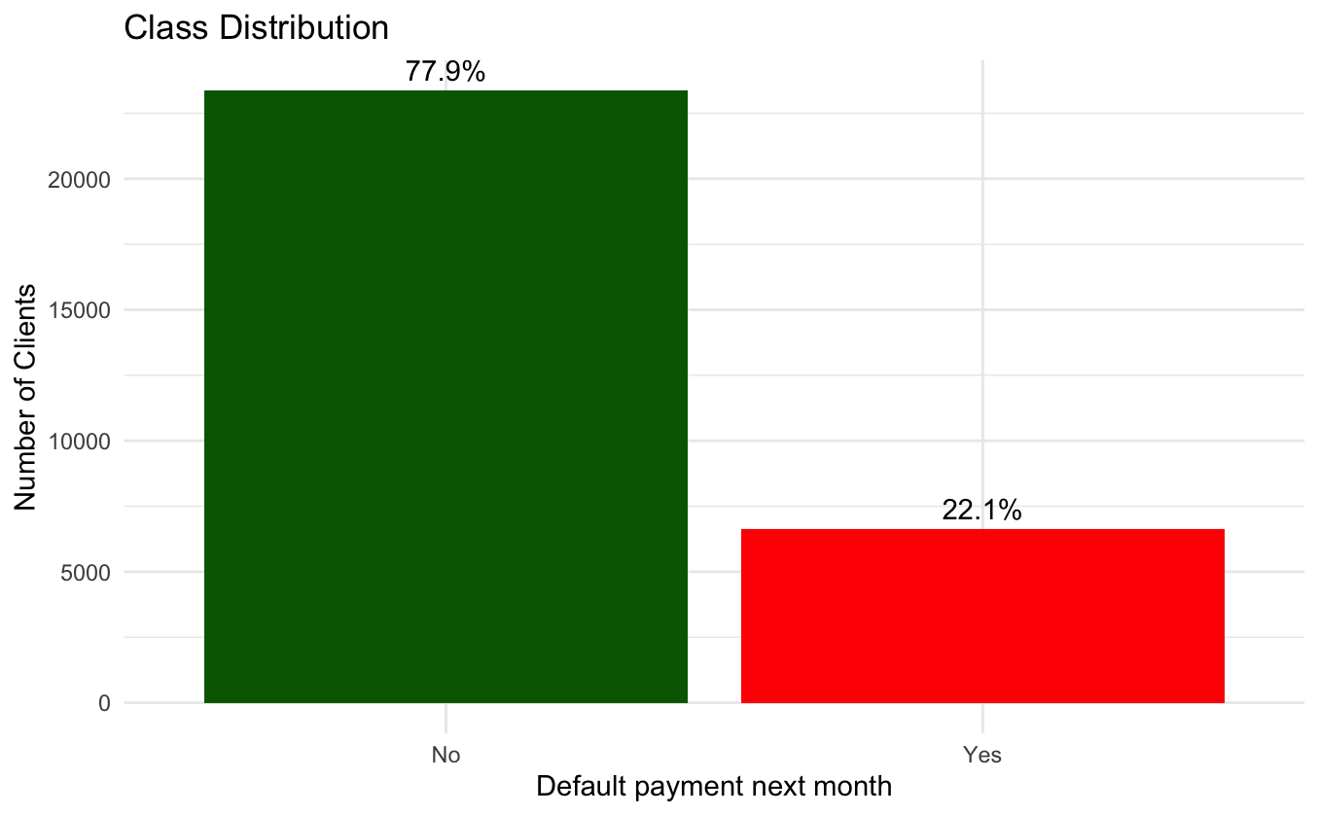
03
Response Variable
MVA Assignment
2024 @ All Rights Reserved - Roger Bukuru
Response Variable Distribution
We note that there exists a class imbalance
The minority class is underrepresented and it will be important for this to be handled before training
Envole

Slide 9

00
The
Problem
Envole PITCH DECK 2023
2024 @ All Rights Reserved - R Bukuru Capital
The Problem
Summarize the problem your product or service solves in one concise sentence.

Slide 10
₀₁ Industry
Insight
Envole PITCH DECK 2023
2024 @ All Rights Reserved - R Bukuru Capital
87%
According to the study, 87% of organizations with a reactive compliance maturity faced negative consequences as a result. Manual compliance programs force teams into a reactive position that can create greater risk and put them in a more vulnerable state.
Envole

Slide 11
₀₂ The
Problem
Envole PITCH DECK 2023
2024 @ All Rights Reserved - R Bukuru Capital
Descriptive one-liner of the problem you’re tackling
This sucks!
Major contributing fact to the problem that is overlooked
This sucks!
Existing solutions do not consider this crucial fact
Widespread impact!
This problem is not a small one
Envole

Slide 12
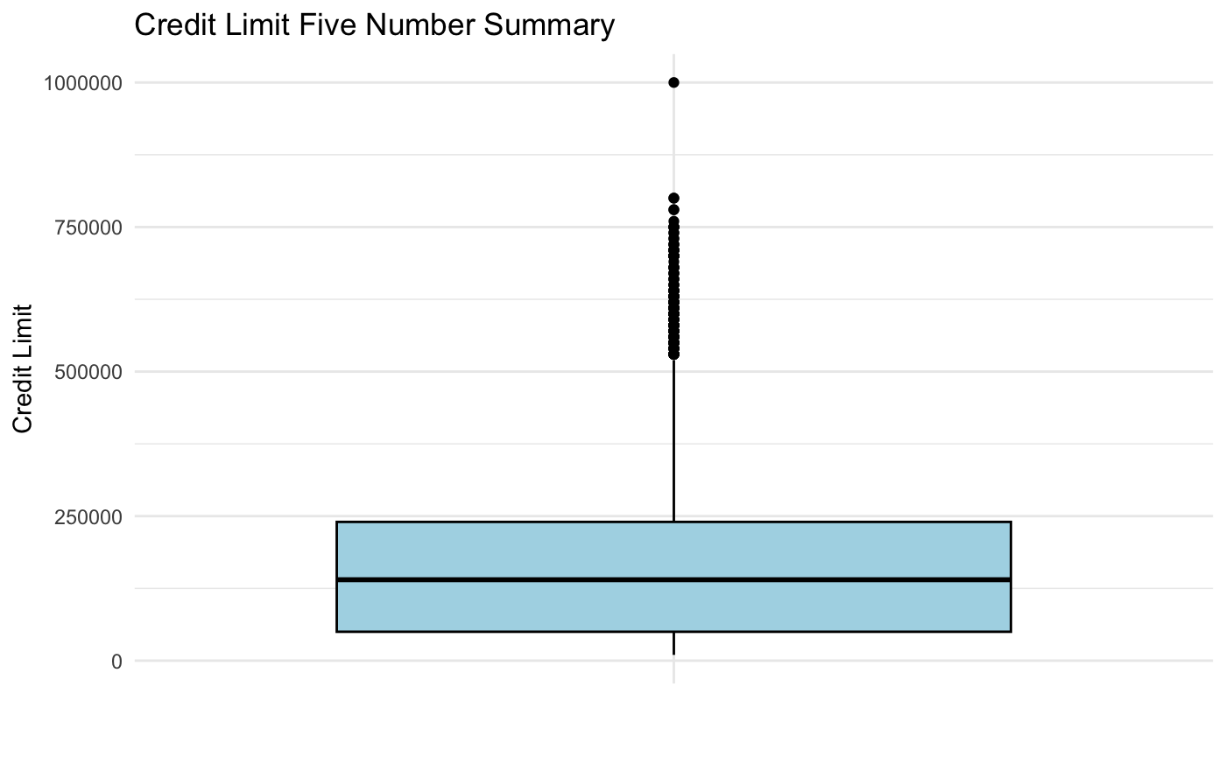
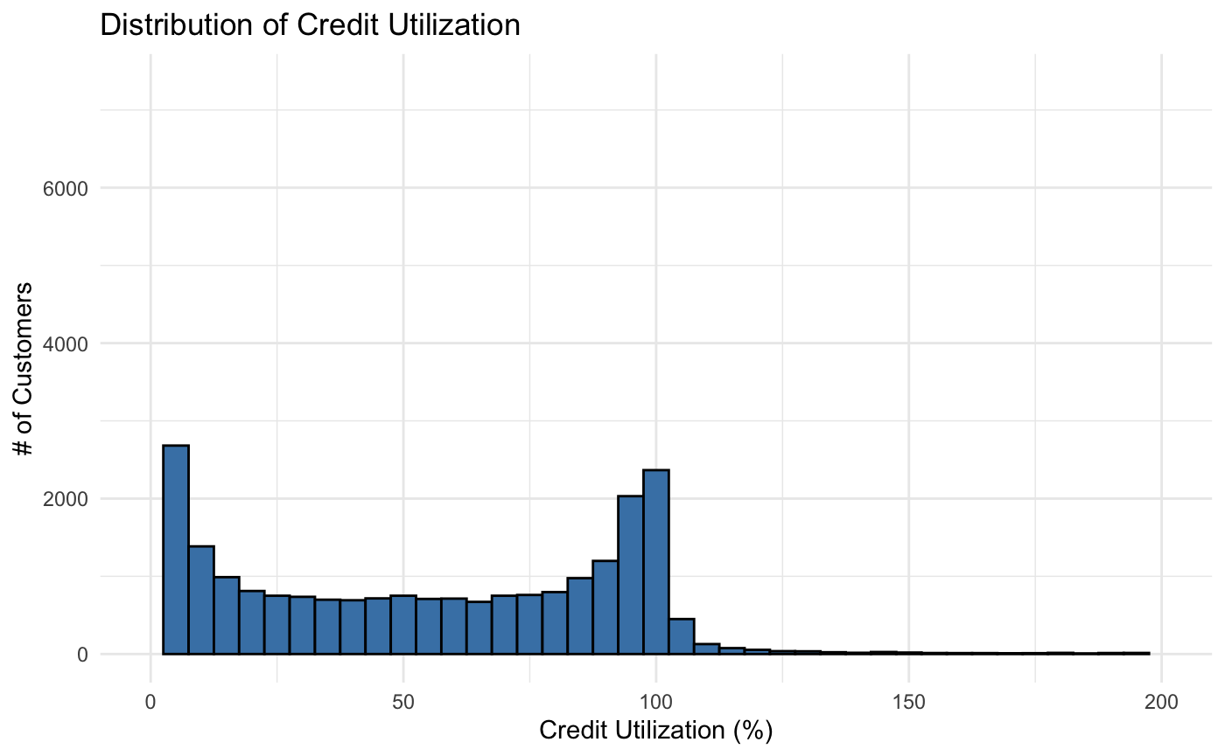
MV Assignemnt
2024 @ All Rights Reserved - R Bukuru
Data Analysis
The minimum credit limit was NT$ 10 000
25% of customers had credit balances of NT$ 50 000 or less, indicating that 75% of clients had credit limit balanaces above NT$ 50 000
The median credit limit was NT$ 140 000, indicating that 50% of customers have credit balances less then 140 000 whilst another 50% of customers have credit limit balanaces above NT$140 000
75% of customers had credit limit balances below NT$240 000 whilst 25% of customers had credit limit balances above NT$240 000
The maximum credit limit was NT$ 1 000 000
There are a few customers that have exceeded their credit limit facility. Indicating several default risk customers
The distribution is left-skewed, indicating that more customers have utilized a large portion of their credit facility than less. This could inidcate that several customers could e at risk of defaulting as they owe more money

Slide 13
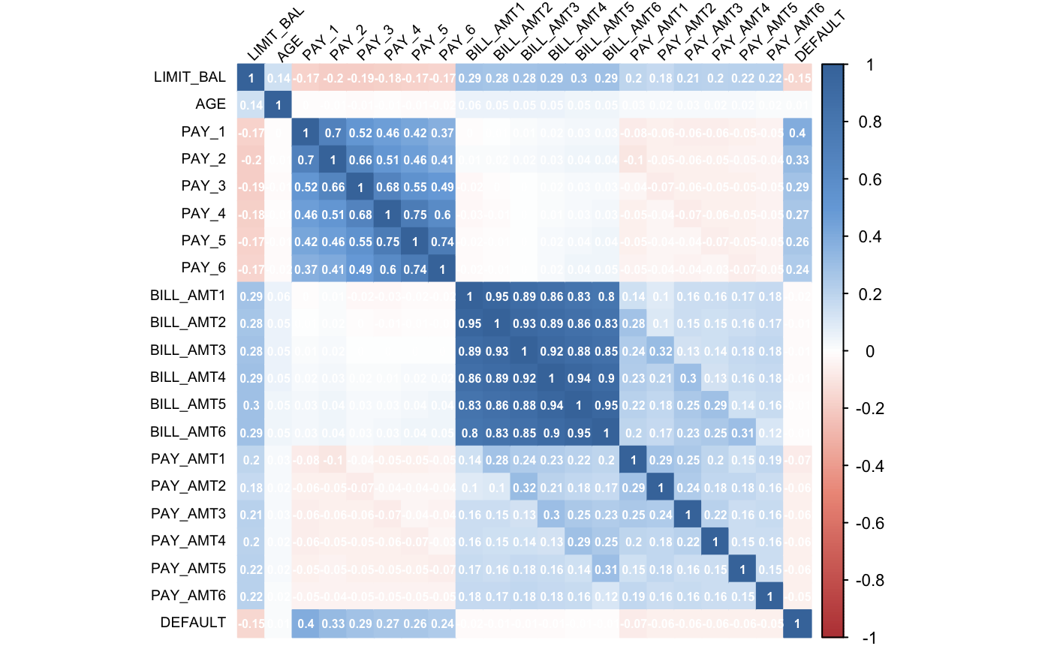
MV Assignemnt
2024 @ All Rights Reserved - R Bukuru
Correlation Analysis
Using the Pearson correlation we observed that there exists correlation between the features.
There is noticeable correlation between the PAYn and BILL_AMT_N features
We note some really high correlations between the BILL_AMT_N features, we decided to keep these, in favour of dealing with them during feature extraction.

Slide 14
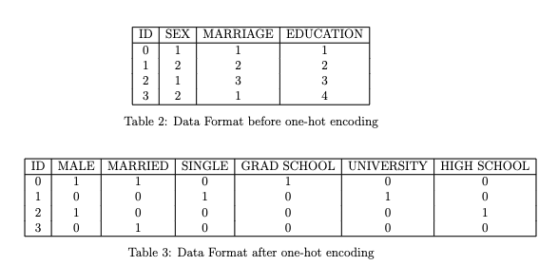
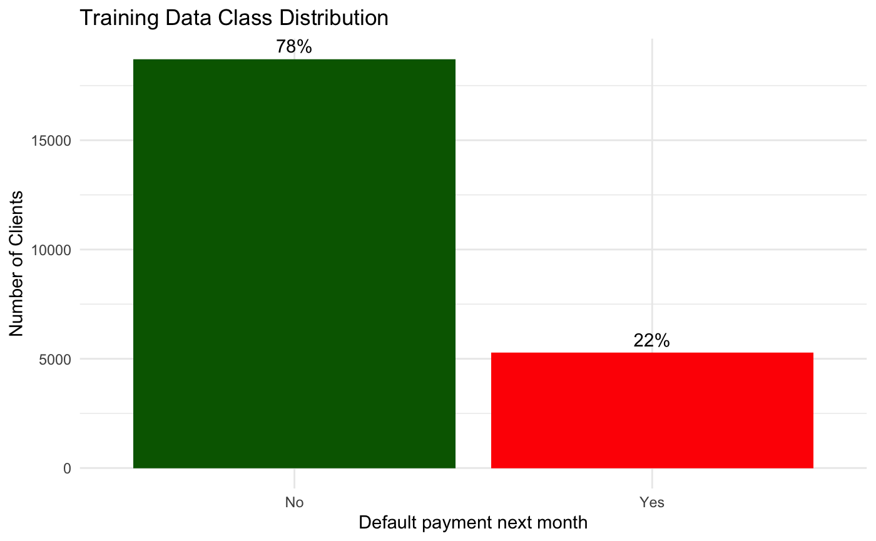

₀₂ Data
Preprocessing
MVA Assiggnement
2024 @ All Rights Reserved - R Bukuru
Data Preprocessing
One-Hot Encoding
Remove any ordinal strucutre on nominal features such as EDUCATION, SEX and MARRIAGE to avoid misbehaviour in the statisical learning algorithms.
Data Partition
80% Training
20% Testing
Feature Scaling
We performed standaridzed such that feature parameters have parameters of a standard normal distribution
Standardization ensures that we maintain the affect of outliers.

Slide 15
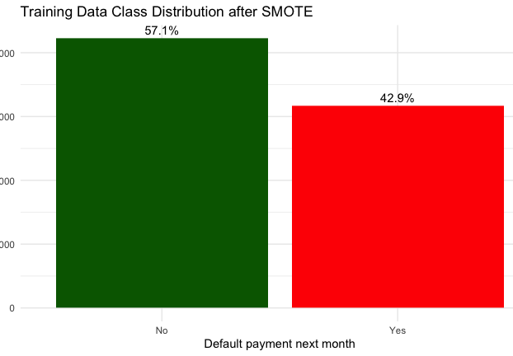
MV Assignemnt
2024 @ All Rights Reserved - R Bukuru
Resampling - SMOTE
Synthetic Minority Oversampling Techniques
An oversampling technique
Only applied to training data, such that when evaluating we maintained the real-world situation
Generates synthetic samples of the minority class using the k-nearest neighbor technique (5 k-nearest neighbors)
Mitigates risk of overfitting
Used the Sampled data for training

Slide 16
₀₂ Data
Preprocessing
PMVA Assiggnement
2024 @ All Rights Reserved - R Bukuru
Data Preprocessing
One-Hot Encoding
Remove any ordinal strucutre on nominal features such as EDUCATION, SEX and MARRIAGE to avoid misbehaviour in the statisical learning algorithms.
Data Partition
80% Training
20% Testing
k-fold cross-validation
Feature Scaling
We performed standaridzed such that feature parameters have parameters of a standard normal distribution.
Standardization ensures that we maintain the affect of outliers.

Slide 17
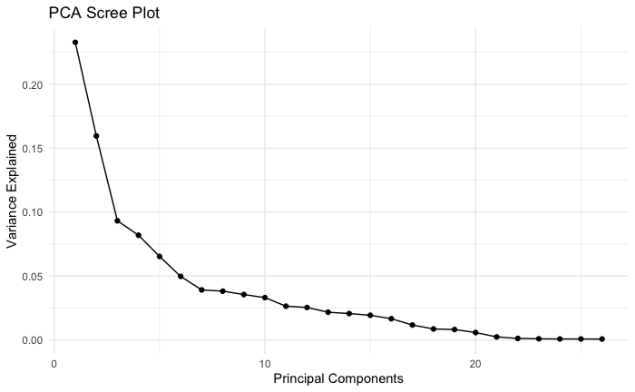
₀₄
Feature Extraction
MVA Assignment
2024 @ All Rights Reserved - R Bukuru
Feature Extraction
Principal Component Analysis
Decrease in Variance
There is a monotonic decrease by the variance explained by each principal component. First three components only capture 48.57%
Icon or number
“Elbow”
Not very pronounced, indicating that the technique is not entirely cpaturing the strucutre of the data and we not that the variance
Envole
Linear Projection Working ?
We will determine this when evaluating the non-linear methods, but thus-far it doesn’t look like the linear projection is capturing the inherent pattern of the data.
Icon or number

Slide 18
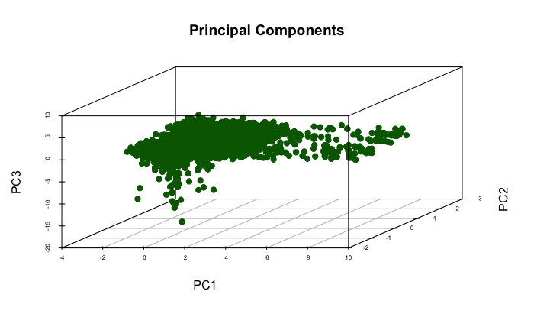
₀₄ PCA
MVA Assignment
2024 @ All Rights Reserved - R Bukuru
Feature Extraction
Principal Component Analysis
Visualizing in 3-D Latent Space
The data points are mostly spread along the first pirncipal component with less variation along PC2 and PC3
Envole
PC1
Caputes the most significant pattern of the variation in the data
Data Pattern
Distribution of points seems to form a somewhat elongated cloud, it’s an interesting pattern indicating that the technique is potentially struggling to capute the true pattern in the data.

Slide 19
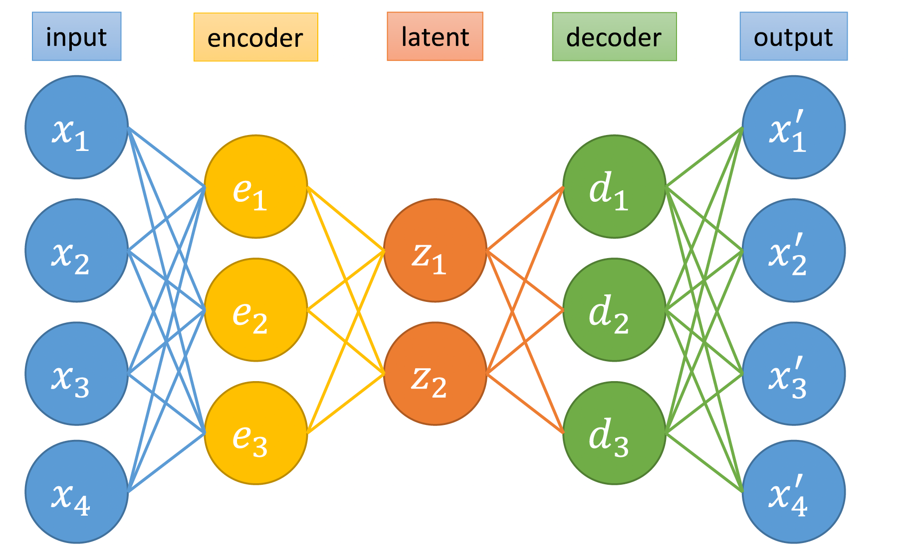
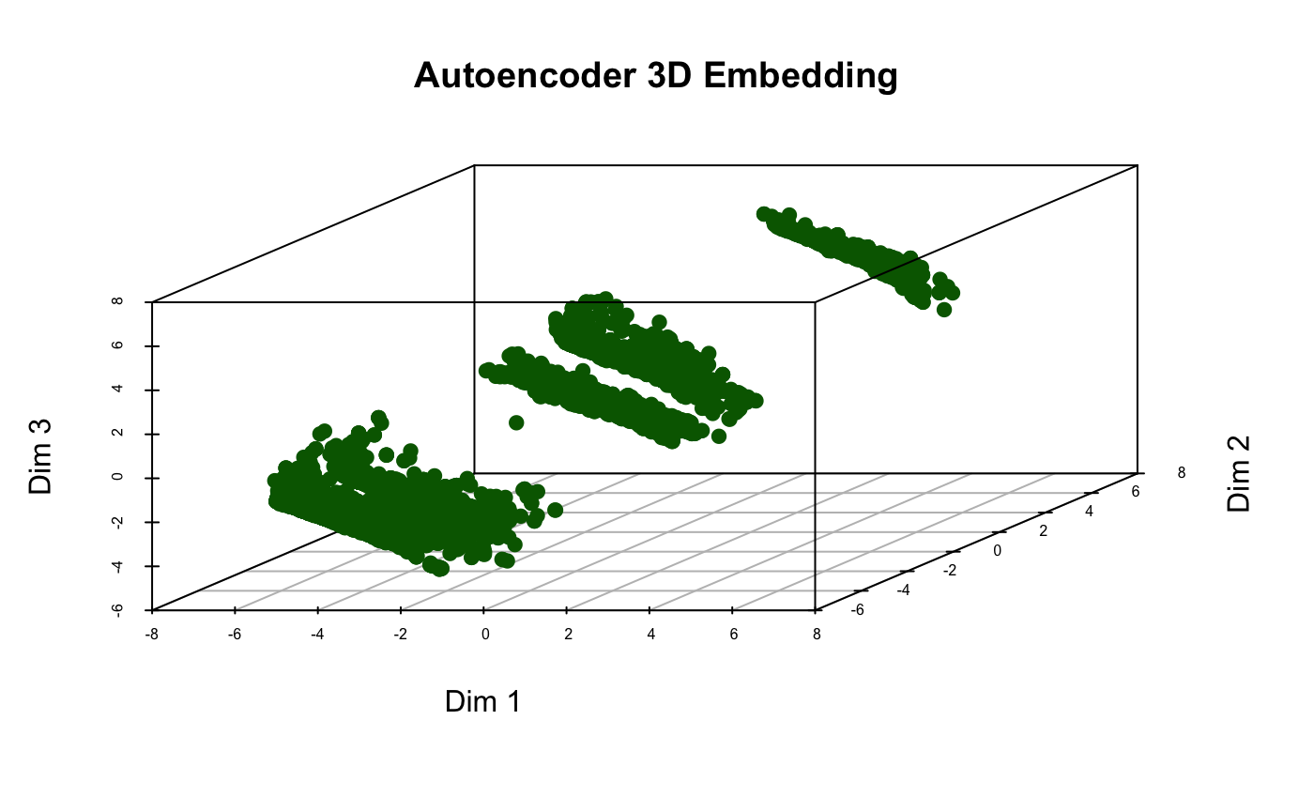
₀₄
Autoencoders
MVA Assignment
2024 @ All Rights Reserved - R Bukuru
Feature Extraction
Autoencoders
What are autoencoders ?
Feed-forward neural networks, that learn efficient encoding of data in a supervised manner. Typically used for dimension reduction
Envole
Connection with PCA
Encoding = PCA Subspace linear Projection
Decoding = PCA Projection to higher dimension
Latent Space Representation in 3-D
We observe a pattern that we initially did not see with PCA. We see various clusters ? i.e that there might be potential customer cluster segments within the credit card default
Notes:
Challenges
Each input mapped to a single point
No relationship between close points
So even though this looks better we need to regularize the latent space to see if we maintain the same data pattern

Slide 20
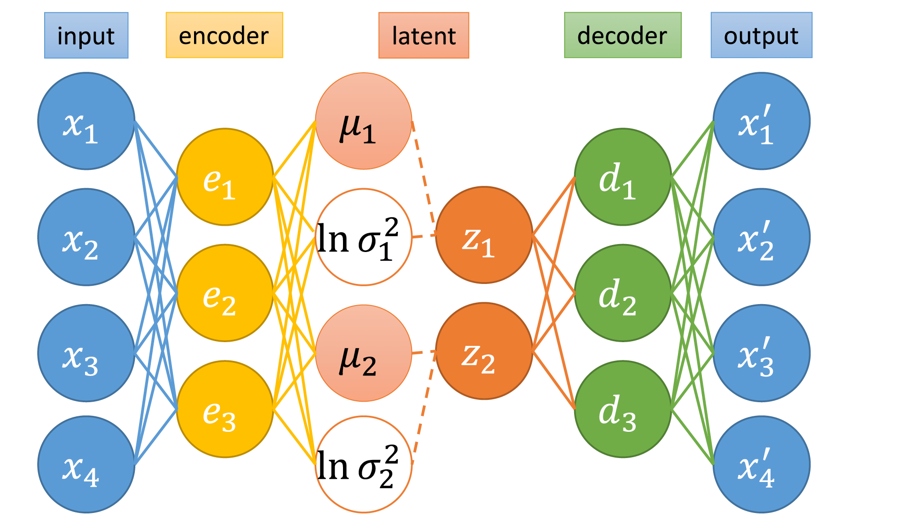
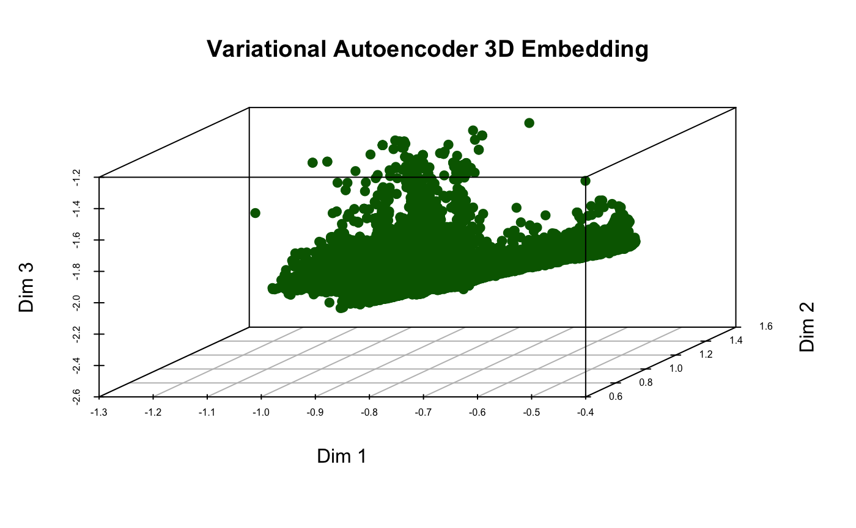
₀₄
Variational Autoencoders
Envole PITCH DECK 2023
2024 @ All Rights Reserved - R Bukuru Capital
Feature Extraction
Variational Autoencoders
What are variational autoencoders ?
A type of generative model that extends autoecnoders. We using it for dimension reduction
Why VAEs ?
VAEs map inputs onto a distribution in latent space rather than a aisnlge points like autoencoders
Latent space may be continous as inputs can simply be ampped to disjoint points in a latent space
By mapping to distributions similar inputs are allowed to have overlapping distributions, allowing interpolation
Envole
Latent Space Representation in 3-D
With a regularized latent space we observe that the previous observed clusters have dissapeared into a smooth continous space, indicating that many of the clients have similar credit behaviour with relation to default then otherwise shown with autoencoder
Notes:
Challenges
Each input mapped to a single point
No relationship between close points
So even though this looks better we need to regularize the latent space to see if we maintain the same data pattern

Slide 21
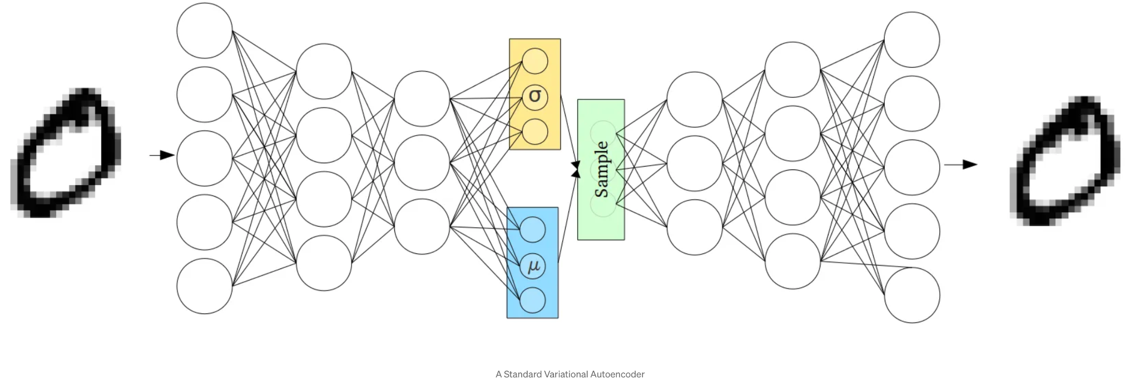
₀₄
Variational Autoencoders
MVA Assignment
2024 @ All Rights Reserved - R Bukuru Capital
Feature Extraction
Variational Autoencoders
What are variational autoencoders ?
A type of generative model that extends autoecnoders. We using it for dimension reduction
Why VAEs ?
VAEs map inputs onto a distribution in latent space rather than a aisnlge points like autoencoders
Latent space may be continous as inputs can simply be ampped to disjoint points in a latent space
By mapping to distributions similar inputs are allowed to have overlapping distributions, allowing interpolation
Envole
Latent Space Representation in 3-D
With a regularized latent space we observe that the previous observed clusters have dissapeared into a smooth continous space, indicating that many of the clients have similar credit behaviour with relation to default then otherwise shown with autoencoder - affect of of prior distribution ?
Notes:
Challenges
Each input mapped to a single point
No relationship between close points
So even though this looks better we need to regularize the latent space to see if we maintain the same data pattern

Slide 22
₀₂
Latent space Performance
MVA Assiggnement
2024 @ All Rights Reserved - R Bukuru
3D Latent Space Evaluation
Principal Component Analysis
Poorest MSE with value of 4.24
MSE calcualted from reconstruction error
Autoencoders
MSE of 0.338
Outperforms PCA
We observe clusters but these may be due to the disjoint mapping
Variational Autoencoders
MSE of 0.590
Clusters ar smoothed out, indicating that a majority of the credit profiles are similar, however with a higher MSE, it more likey that the autoencoder represantion is best

Slide 23
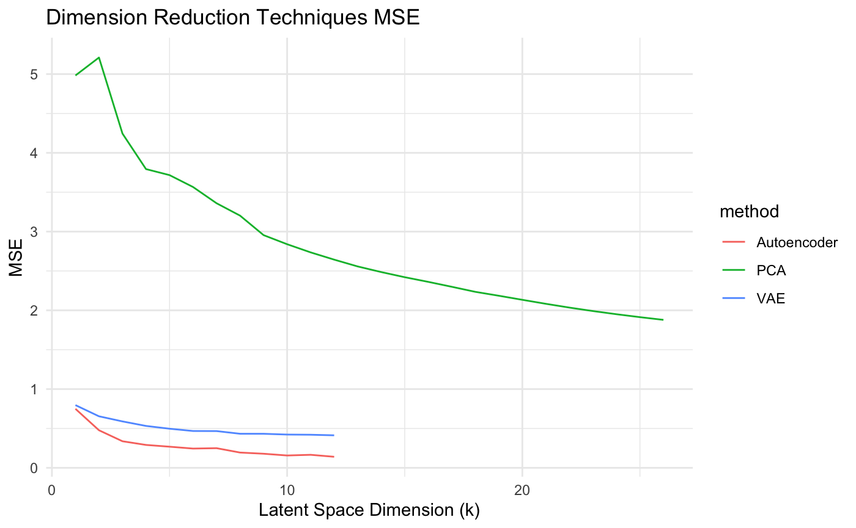
₀₂
Dimension ReductionPerformance
MVA Assiggnement
2024 @ All Rights Reserved - R Bukuru
Dimension Reduction Performance
Principal Component Analysis
Has overall poorest MSE, with lost peaking at all the principal components
Roughly 13 PCAs provide 90% of the exaplined variation
Autoencoders
For the given hyperparameters best performance was at a code size of 12, with MSE 0.140
Variational Autoencoders
For given hyperparamters best performane was at a code size of 12 as well with MSE of 0.412
So autoencoders outperform it besides the regularization

Slide 24
₀₂
Preliminary Conclusions and Next Steps
PMVA Assiggnement
2024 @ All Rights Reserved - R Bukuru
Preliminary Conclusions and Next Steps
Non-linear Data
The non-linear dimension reduction techniques have definitely caputered the best pattern within the data
Autoencoders outperformed the other techniques
Hyperparamter tuning ?
Support Vector Machines
Evalute with raw data (79% accuracy)
Evaluate with PCA
Evaluate with Autoencoder
Evaluate with Variational Autoencoders
Linear Dicrimant Analysis
Evalute with raw data
Evaluate with PCA
Evaluate with Autoencoder
Evaluate with Variational Autoencoders

Slide 25
2024 @ All Rights Reserved - R Bukurul
MVA Assignment
Thank you

